Slide 1


Recognizing Fishing Activities via VMS Trace Analysis Based on Mathematical Morphology
Yuan Zong¹, Haiguang Huang¹², Feng Hong¹, Yong Zhen¹ and Zhongwen Guo¹
¹Ocean University of China
²Wenzhou Ocean and Fishery Vessel Safety Rescue Information Center
Notes:
Good morning everyone.
I am Zong Yuan, from Ocean University of China.
My presentation is about Recognizing Fishing Activities via VMS Trace Analysis Based on Mathematical Morphology.

Slide 2






Why This Work
VMS data
Notes:
In decades of years, the Vessel Monitoring System data has been used in many ways.
To provide the vessels’ location, the interaction between different vessels, fuel cost.
Or, based on the location, to estimate fishing effort and environmental pressure further.

Slide 3



Why This Work
Recognition of fishing activity is the key issue
Notes:
And in this research area, recognition of fishing activity is the key issue.

Slide 4
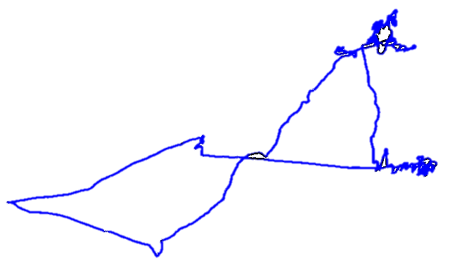


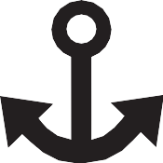
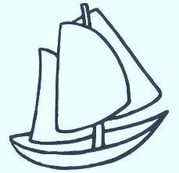
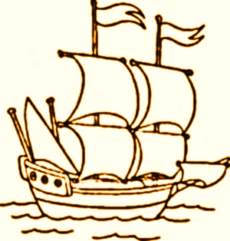

Related Work
Misjudge speed reduction as fishing activity
Thresholds vary with vessel types
Experience-based Method
Notes:
The previous researches can be divided into two categories.
One is the Experience-based Method.
This kind of method is basically based on the fishing experience that vessels’ speed can be quite different during different activities.
As it can be fast during steaming activity, and slow down during fishing activity.
Well although simple and direct, it will misjudge speed reduction as fishing activity, like these two turnings.
And thresholds vary with vessel’s different types.

Slide 5
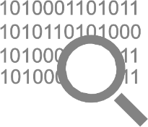
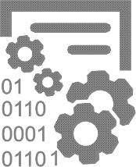




Related Work
Amount of labeled data to train the model
Additional references come from other sources
Statistic-based Method
Notes:
The other one is the Statistic-based Method, like the Hidden Markov Model.
To be robust, this kind of method needs amount of labeled data to train the model.
Besides, to label the data, additional references, like observers’ records or logbooks, are required to characterize the VMS data.

Slide 6
Challenges
No extra references ?
Still efficient and robust ?
Notes:
So, how about a new method, which needs no extra references, and is still efficient and robust?

Slide 7
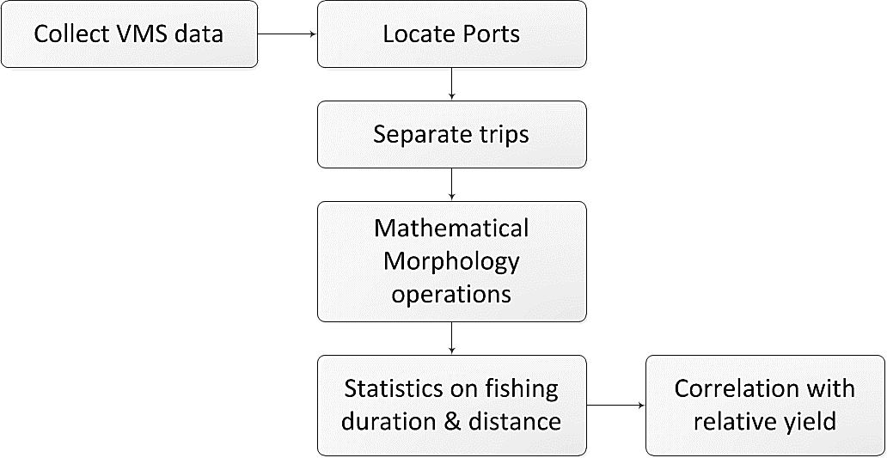
FAR: Fishing Activity Recognition System
Notes:
This is our proposed system, FAR, fishing activity recognition system.
It only digs into VMS data. Facing a mass of traces, we need to locate the ports first, so that we can separate trips.
And do Mathematical Morphology operations to recognize fishing activity and get fishing duration and distance.
A step forward, we explore the correlation between fishing metrics and relative yield as well.

Slide 8
VMS Data
34 otter trawl vessels
Duration from 1st Apr 2014 to 30th Jun 2016
2,140,288 records in total
A rated 60-second temporal resolution
Recorded by Zhejiang Province Ocean and Fisheries Bureau
Notes:
Our VMS data is from 34 otter trawl vessels, the duration is more than 2 years.
It contains more than 2 million records in total with a rated 60-second temporal resolution instead of a 2-hour one.
All the data is provided by the Zhejiang Province Ocean and Fisheries Bureau.

Slide 9

Locate Ports
Analyze all these overlapping fishing trips, directly ?
Notes:
This is what our data provides us primarily.
Are we gonna analyzing these overlapping traces directly?
What’s more, we don’t have any information about individual trips at all.
Well, let’s locate the ports first.

Slide 10
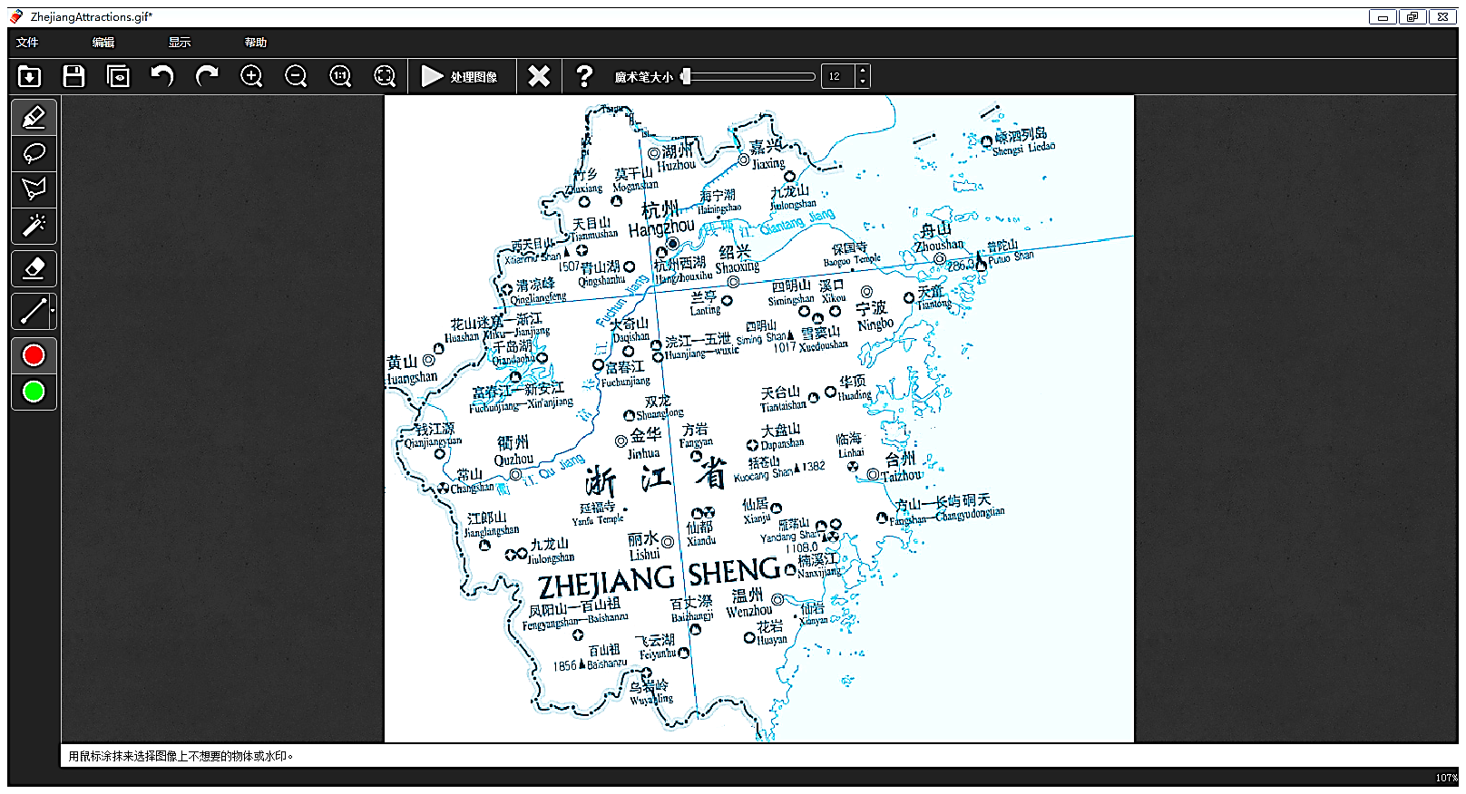
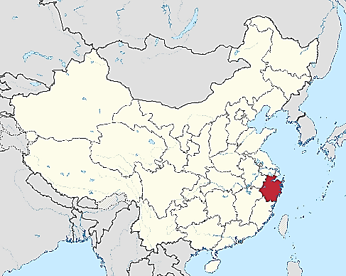
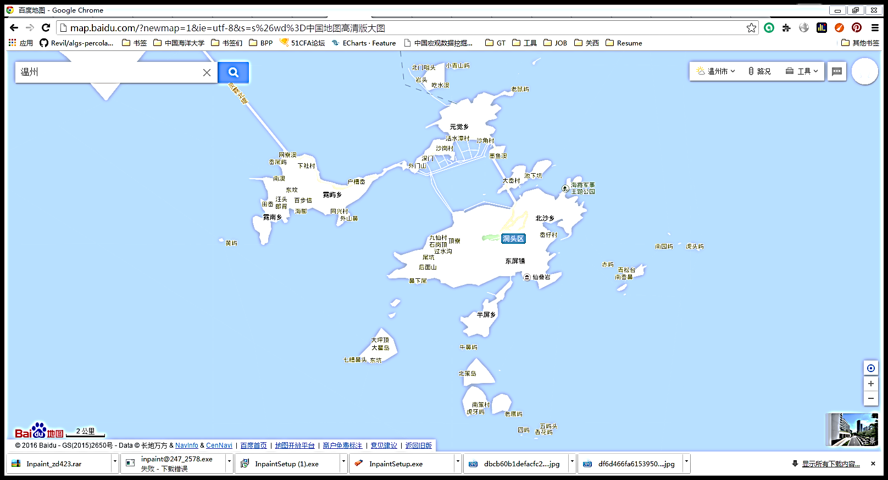
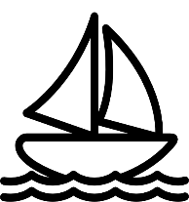
Locate Ports
Unrecorded ports scatter
Anchored vessels move
Notes:
In reality, small villages and tiny ports scatter along the coast.
Even a little normal island can be like this, there’s no map accurate enough to mark all the ports.
Besides, because of the wind and waves, even the anchored vessel moves slightly.
So we can’t find the ports just rely on the speed.

Slide 11
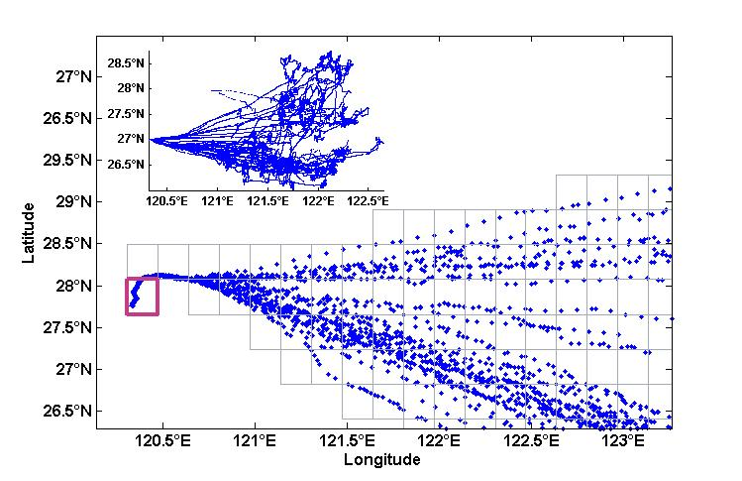
Locate Ports
Set the grid as 1´latitude × 1´longitude
Statistics of records of the vessel’s speed and heading
The grid with the maximum record number is selected as the port
Notes:
So, no maps, no logbooks.
We divide the whole geographical area of each vessel into grids, sized as 1’ longitude multiply 1’ latitude.
By statistics of the records whose speed and heading are in rated ranges,
The grid with the maximum record number is selected as the port.

Slide 12
Separate Trips
Individual trips are separated
Notes:
Now, individual trips are separated.

Slide 13
Recognize Fishing Activity
Targets are according to
Productive mode of trawlers
60-second temporal resolution
Problem
Fisherman can tell where the fishing activity is by a glimpse
Computer can not do this
Notes:
Thanks to the productive mode of trawlers and the 60-second temporary resolution, the fishing activity can be targeted here and here, the meandering traces.
Our problem is, the fisherman can tell where the fishing activity is even by a glimpse.
But the computer can not do this.

Slide 14
Recognize Fishing Activity
Fishermen see Computer see
Mathematical Morphology
Notes:
How to make the computer see what the fisherman see?
Mathematical Morphology, a picture processing approach, which provides an advantage of simplifying traces.

Slide 15
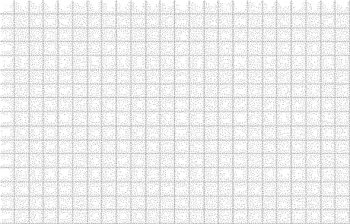
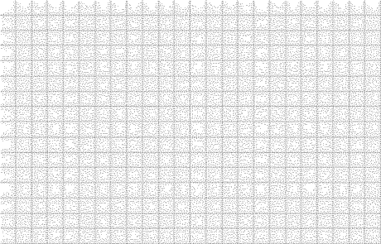
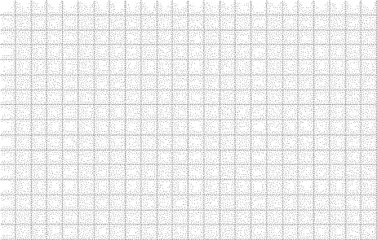
Recognize Fishing Activity
Preprocessing
Detect the boundaries of each individual trip
Expand the image 0.16° both for the longitude and latitude
Divide the new image into 0.1´longitude×0.1´latitude sized pixels
0.16°
Notes:
For the preprocessing, first we detect the boundaries of each individual trip.
To make room for the following operations, we then expand the image both for the longitude and latitude.
And divide this new image into

Slide 16
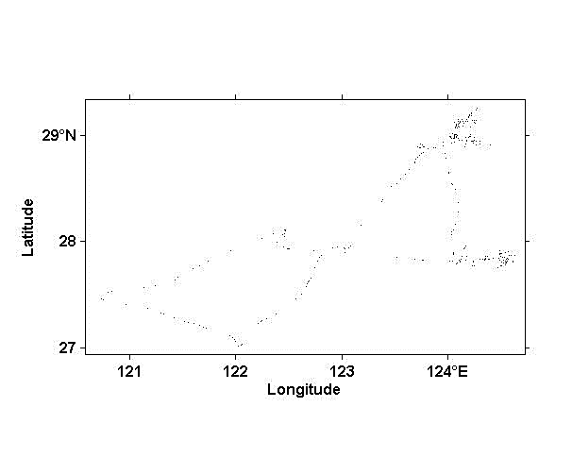
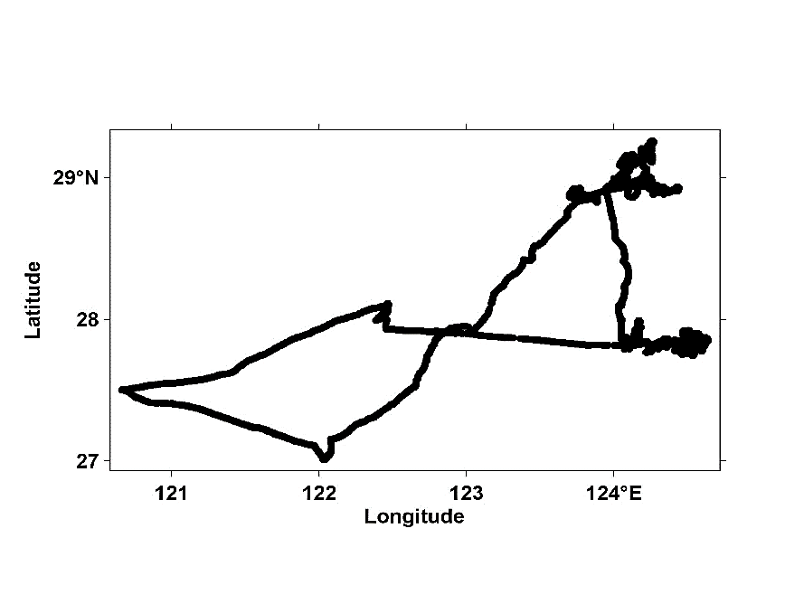
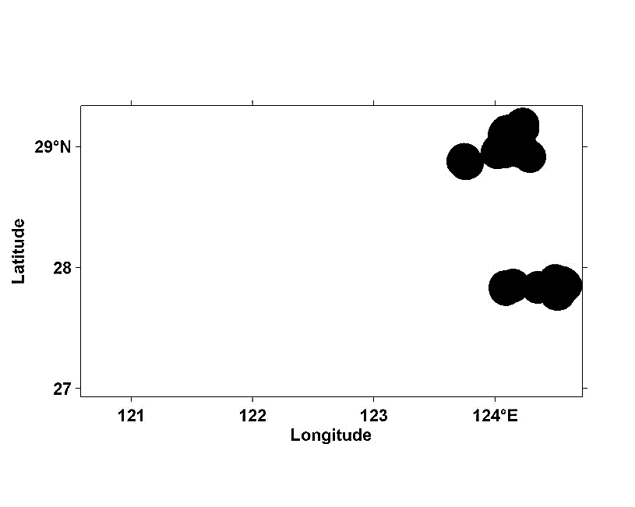
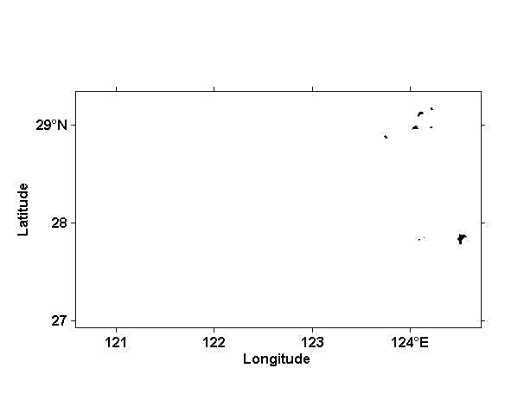
Recognize Fishing Activity
Erosion
Mathematical Morphology
operations
Dilation
Erosion
Notes:
And now, Mathematical Morphology operations.
The key of this approach is to make the fishing traces stand out of the whole trajectories.
As we can see from the first image, presented by the primary recorded points, although the fishing activity shows a zigzag tendency, these scattering points are not distinct enough.
By operating erosion, all the points become more evident and start to get connected with each other.
Well our goal is to eliminate the steaming traces and preserve the fishing traces.
By dilation, the core regions and outlines of fishing traces are preserved.
However these preserved regions are too small to indicate all the fishing traces.
So we operate another erosion to expand the fishing components, as large enough to illustrate the actual fishing activity.

Slide 17
Recognize Fishing Activity
Statistics on fishing activity
Locate where the fishing activity starts and ends
Obtain metrics of fishing duration and distance
Notes:
Referring back the recognized fishing area to the primary trace, now we can locate where the fishing activity starts and ends.
For example, for this area, fishing activity starts at point A and ends at point B. So as the other areas.
According to the VMS records, so we can obtain metrics of fishing duration and distance.

Slide 18
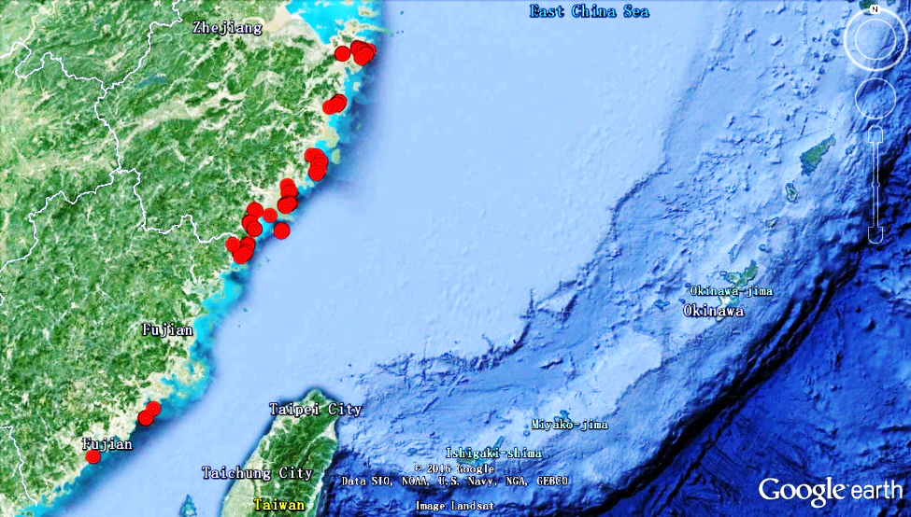
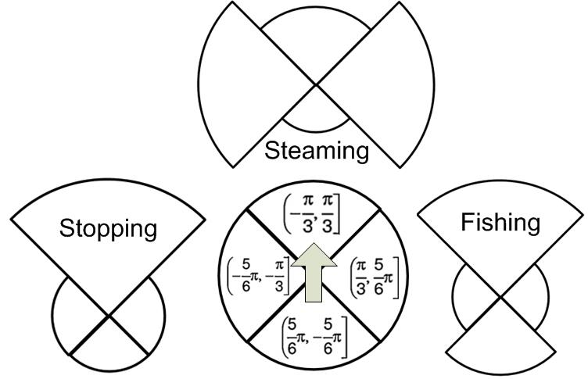
Result
6 knot
1 knot
4 knot
Validate the located ports on Google earth
Validate the metrics of speed and heading

Slide 19
Result
Validate the located ports on Google earth
Notes:
We employ out system on all the 34 vessels’ data.
As the foundation of all the operations, we first validate the located port on Google earth.
As we can see from the picture, all the located ports are along the coast, and actually, some of them even indicate inshore islands precisely.

Slide 20
Result
Activity | Average Speed (knot)
Stopping | 1
Steaming | 6
Fishing | 4
Validate the metrics of speed and heading
Notes:
So we actually divide one trip into stopping, steaming and fishing 3 types of activities.
We abstract the relative VMS data of speed and heading, and the statistics shows a mutual corroboration with the previous researches.

Slide 21
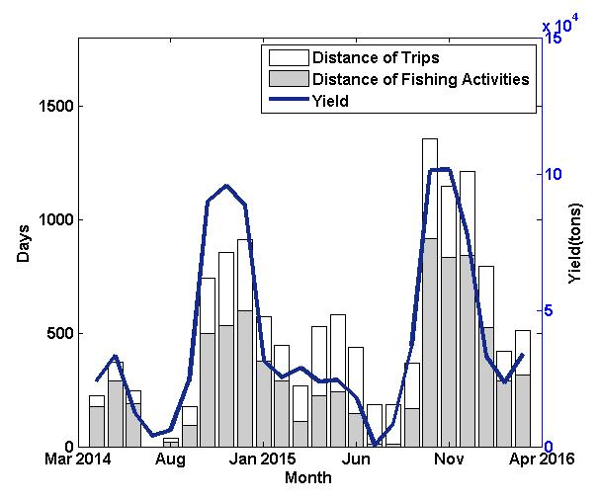
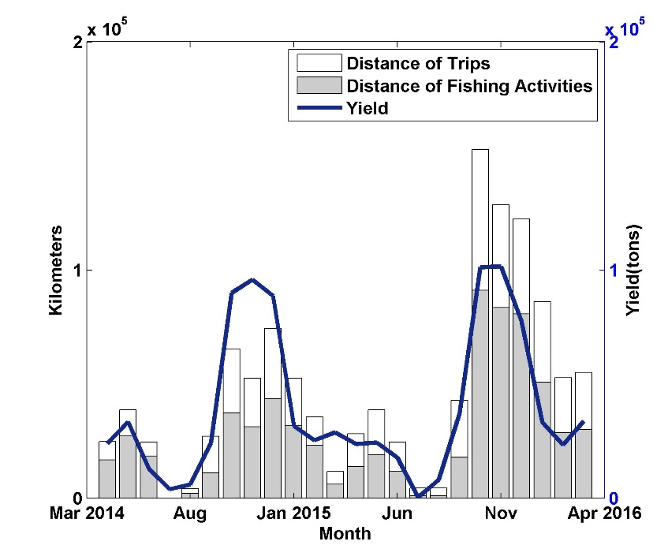
Result
The correlation between statistics on fishing durations and distances and yield survey are 89.80% and 82.11% respectively
Notes:
A step forward, we get the fishing and whole-trip duration and distance for each month of all the vessels.
To evaluate our fishing statistics, we exploit the month fishing yield survey.
The correlation between statistics on fishing duration and distance and yield survey are around 90% and 82% respectively.

Slide 22
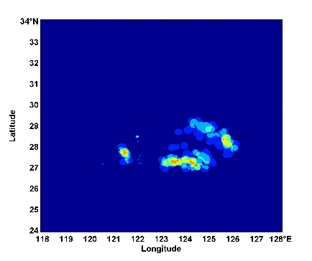
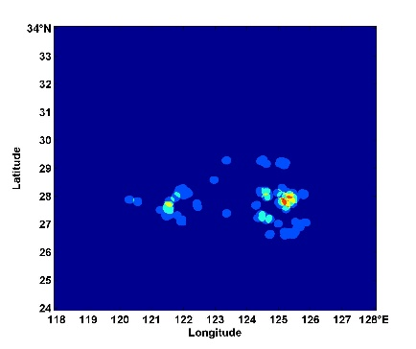
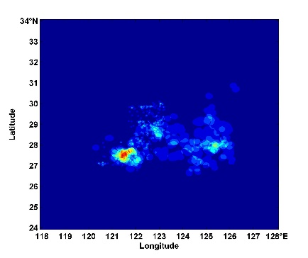
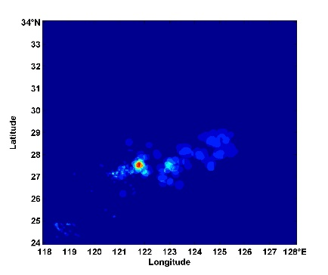
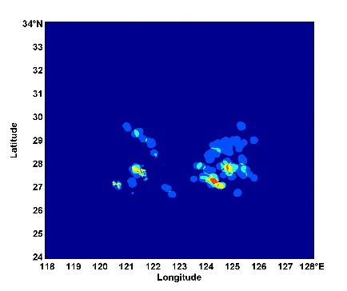
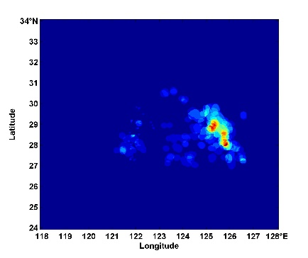
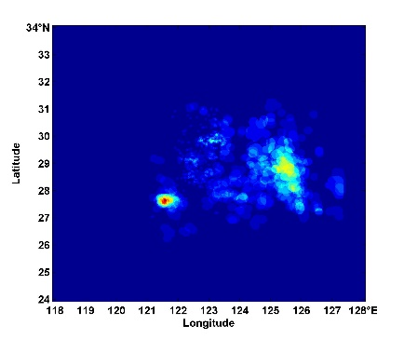
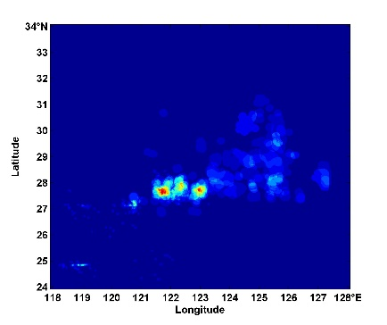
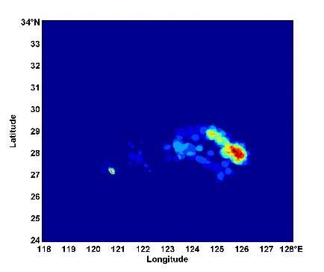
Result
Heap maps of recognized fishing areas per quarter
2nd Quarter, 2014—2nd Quarter, 2016

Slide 23
Result
1st
2nd
3rd
4th
2014
2015
2016
Heap maps of recognized fishing areas per quarter
2nd Quarter, 2014—2nd Quarter, 2016
Notes:
As we label the fishing areas of every trips, we digitalize all the fishing areas of the sample vessels per quarter, in order to show the transformation of productive regions.

Slide 24
Conclusion
1
2
3
Mathematical
Morphology
Material
Further Correlation
Relies on a 60-second temporary resolution and the productive pattern of otter trawl.
Approach of picture processing
Realize fishing activity recognition with VMS data only.
Explore the correlation between the changes of fishing activity and the relative yield.

Slide 25
Thank You
Q & A
ZONG Yuan
juliazgyn@gmail.com
Department of Computer Science
Ocean University of China

